Slide 1



Image Recognition with IBM Cloud Visual Recognition

Slide 2
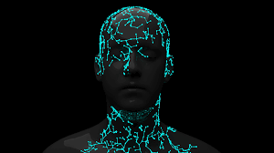
Content
01
Problem Statement
02
Design thinking
03
Problem solving statement
04
Advantages

Slide 3

01
Problem Statement
The problem at hand is to develop an advanced image recognition system using IBM Visual Recognition technology.
This system should be capable of accurately classifying and identifying objects or concepts within images across various domains and applications.

Slide 4
02
Design Thinking
Create an IBM Cloud Account: If you don't have one, sign up for an IBM Cloud account.
Set Up Visual Recognition: Create a Visual Recognition service instance in your IBM Cloud account.
Collect and Prepare Data: Gather a dataset of images that you want to classify or analyze. Make sure you have labeled examples for training.
Train Your Model: Use the Visual Recognition service to train your model using your dataset. IBM Visual Recognition uses machine learning algorithms to learn from the labeled data.

Slide 5
Test and Deploy: Once your model is trained, you can test it to ensure it's making accurate predictions. You can also deploy it to make predictions in real-time
Integrate with Your Application: Integrate the Visual Recognition API into your application or service to use it for image analysis.
Monitor and Improve: Continuously monitor the performance of your model and retrain it with new data if necessary to improve its accuracy.
You can use the IBM Watson Visual Recognition API to interact with the service programmatically, allowing your applications to make image recognition requests and receive predictions.Please note that the specific steps and features of IBM Visual Recognition may change over time, so it's essential to refer to IBM's official documentation for the most up-to-date information and guidance on using the service.

Slide 6
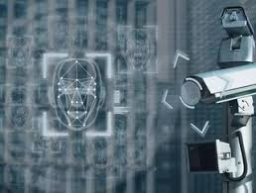
03
Problem Solving Statement
Develop a robust image recognition system using IBM Visual Recognition to accurately classify objects and scenes in real-time, optimizing for both speed and accuracy.

Slide 7
Advantages of using IBM Visual Recognition for image recognition
04
High Accuracy: IBM Visual Recognition leverages deep learning models to achieve high accuracy in image classification and object detection tasks.
Customization: You can train and fine-tune the model to recognize specific objects or concepts tailored to your unique use case.
Ease of Use: It provides user-friendly tools and APIs that simplify the process of building, training, and deploying image recognition models.
Scalability: IBM Visual Recognition is designed to handle large-scale applications, making it suitable for both small projects and enterprise-level solutions.
Versatility: It supports a wide range of image types, including static images and video frames, making it versatile for various applications.

Slide 8
Cloud-Based: Being cloud-based, it offers easy access and scalability without the need for extensive hardware or infrastructure setup.
Integration: It can be integrated into existing applications and workflows, facilitating seamless incorporation of image recognition capabilities.
Security: IBM's security measures help protect your data and models, ensuring the privacy and confidentiality of your image data.
Global Reach: IBM has a global presence, providing reliable access and support to users around the world.
Continuous Improvement: IBM regularly updates its models and technology, ensuring that your image recognition system benefits from the latest advancements in AI and machine learning

Slide 9
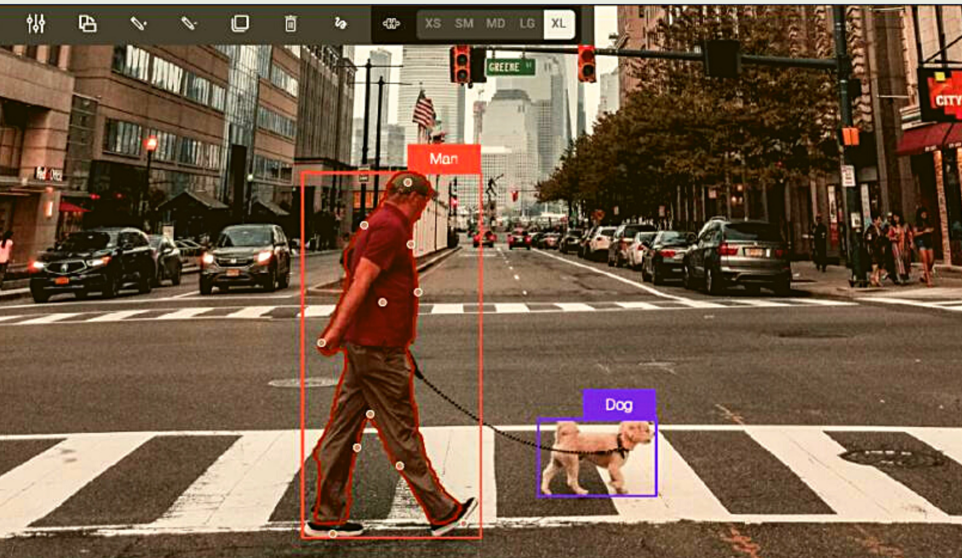

Thank You

